Slide 1
Theatre Booking And Management System
Developed By Patel Jyot Kalpesh

Slide 2
Introduction To Project
This project is aimed to provide a system to cinema hall owners a digital manner of managing the movie shows and ticket booking within a single application. Through this project we present a comprehensive solution for ticket booking in multiplexes. User can easily book tickets for the customers coming to the cinema hall. Admin can use this Project to insert and delete data such as movie description, movie schedule which will update the system to display updated data for the ease of explanation about a particular movie and admin can check the statistic information from the system.

Slide 3
Scope Of Work
This Theatre Booking and Management System can be used by Multiplexes. As it is user friendly and easy to operate application it can be used with simple operational knowledge of the system. Every software may have some cases of bugs, errors, security related problems or system faults.
Admin and Employee have to power to book tickets for a customer.
The system handles all the operation and generates reports.
Admin can update the Active Movie List, Time Table, Price of Tickets, and Manage Cash Counter.
The System generates a Ticket on Successful Payment.

Slide 4
Existing System
Existing system is a manual one in which users are maintaining books to store the information like Active Movies, Show Schedule Details, Price Details, and Manual hand written Tickets for movies as per schedule. It is very difficult to maintain data related to net sell of tickets and gross collection at the theatre.
The following drawbacks of existing system emphasize the need for computerization:
A lot of Tickets are distributed and a record is hard to maintain.
A lot of tabulation work for each scheduled show

Slide 5
HARDWARE & SOFTWARE SPECIFICATION
FOR DEVELOPMENT
TO RUN APPLICATION
Hardware Requirements:
Intel – I5 (Processor).
8 GB Ram
Hard disk 10 GB
Display, Mouse, Keyboard
Software Requirements:
Operating System: Windows 11
System Type: 64-bit
Framework: .NET Framework 4.8
Hardware Requirements:
Intel - I3 (Processor).
2 GB Ram
Hard disk 10 GB
Display, Mouse, Keyboard
Software Requirements:
Operating System: Windows 7 or Above
System Type: 32-bit and 64-bit
Framework: .NET Framework 4.5 or Above

Slide 6
Data Flow Diagrams

Slide 7
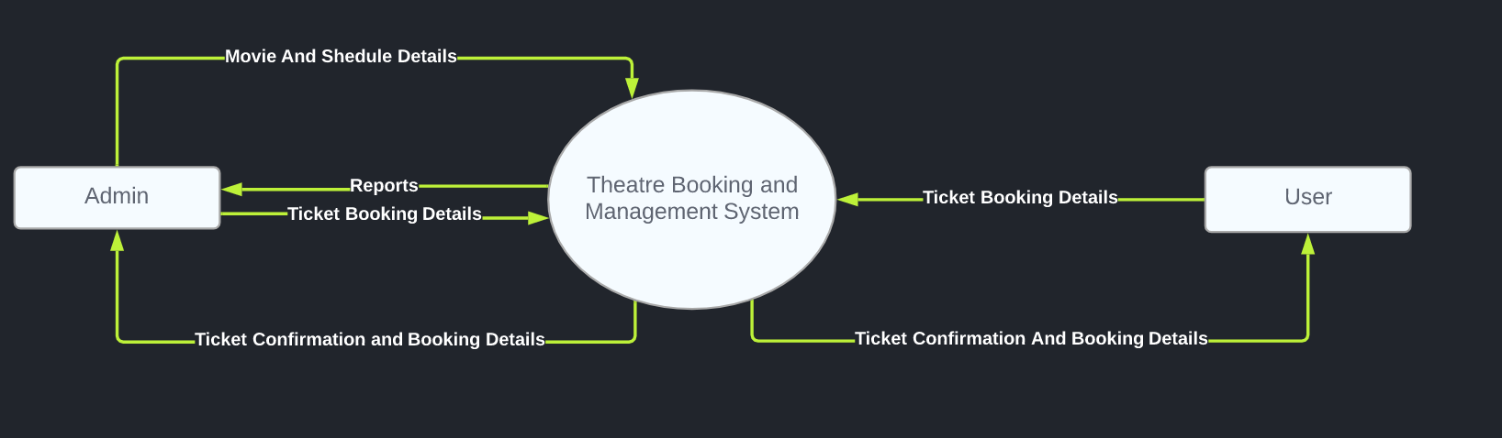
Context Level DFD

Slide 8
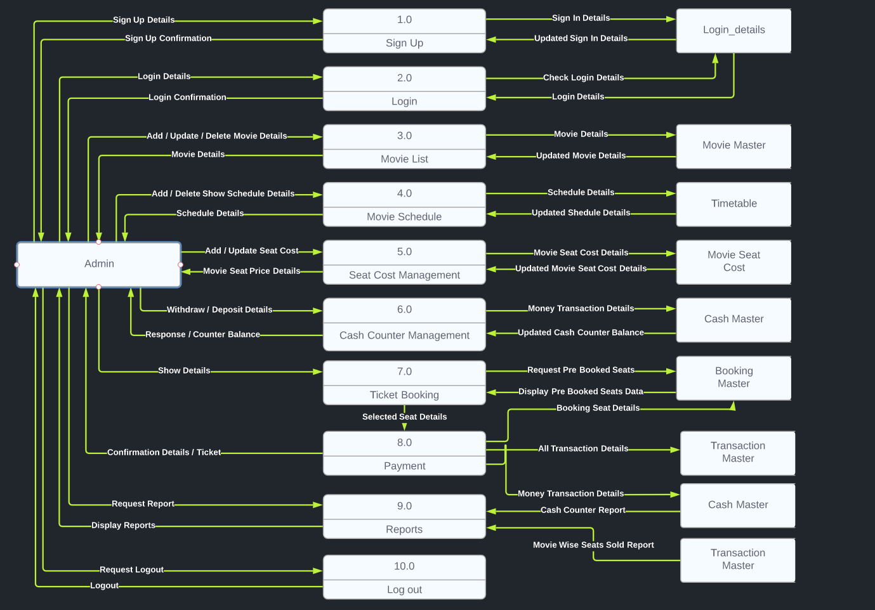
Zero Level DFD - Admin

Slide 9
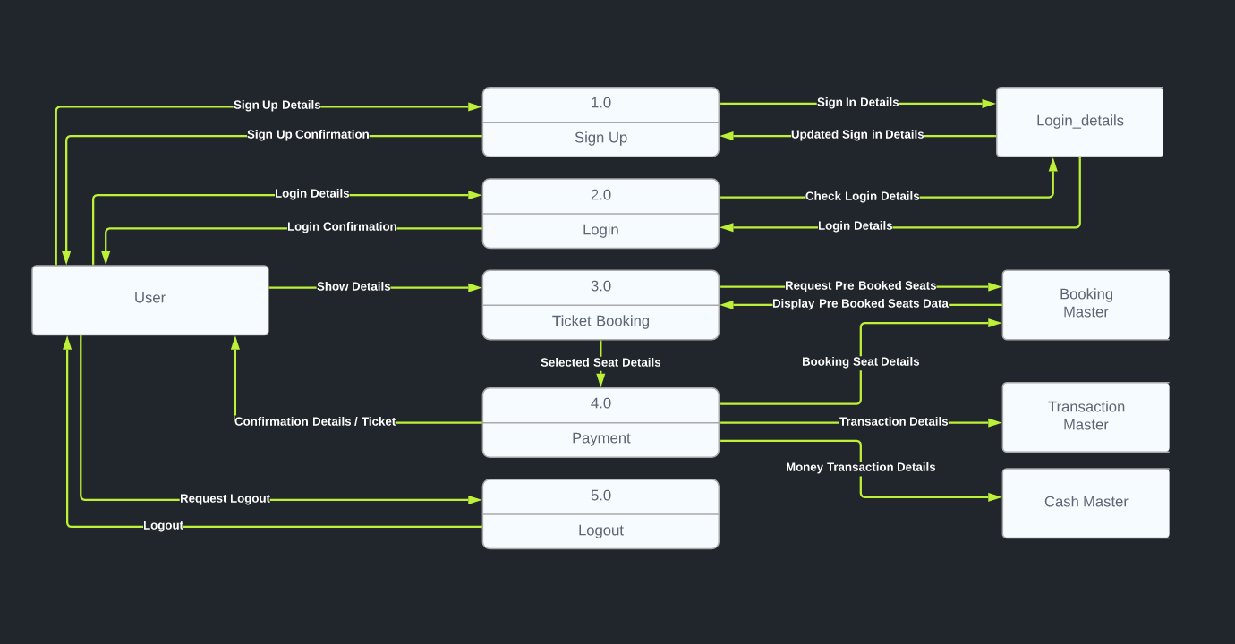
Zero Level DFD - User

Slide 10
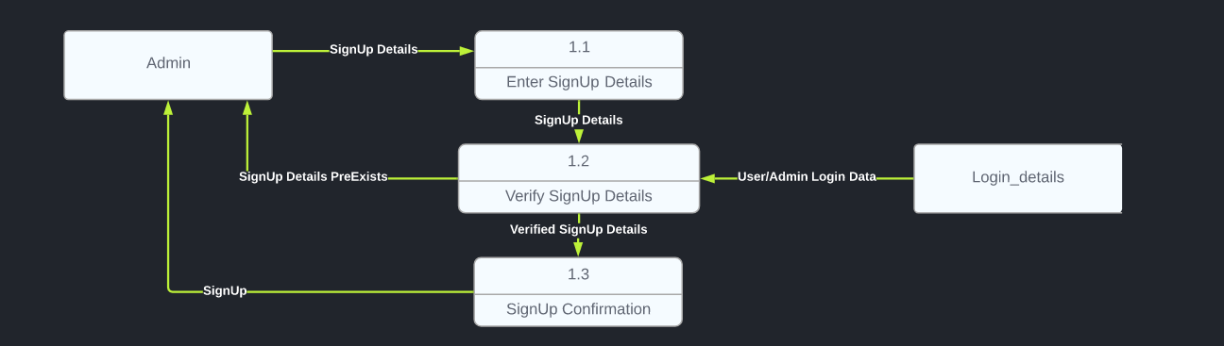
First Level DFD - Admin
1) SIGN UP

Slide 11
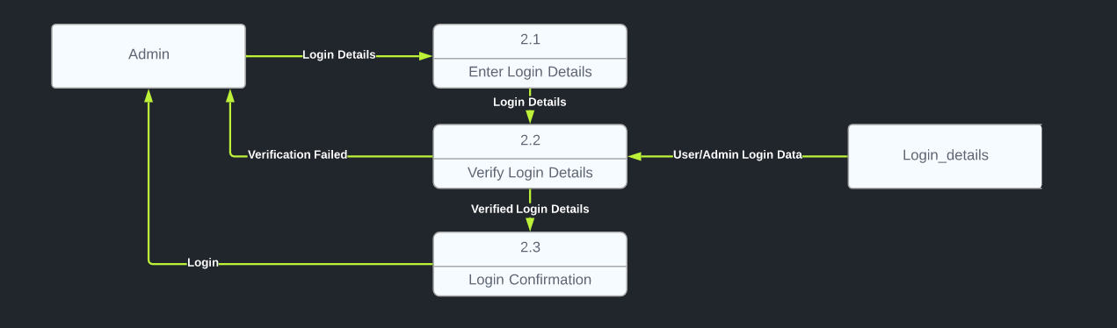
First Level DFD - Admin
2) LOG IN

Slide 12
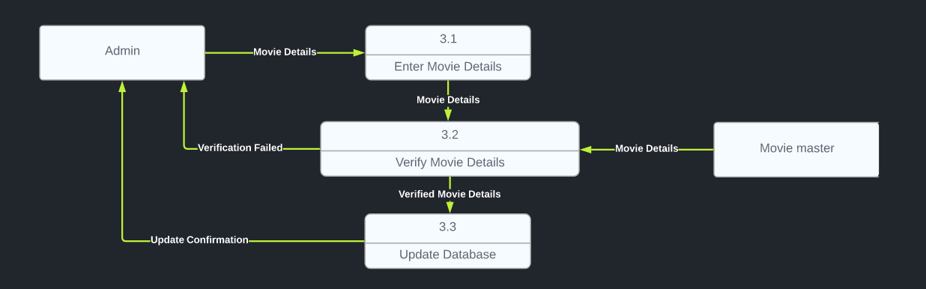
First Level DFD - Admin
3) MOVIE LIST

Slide 13
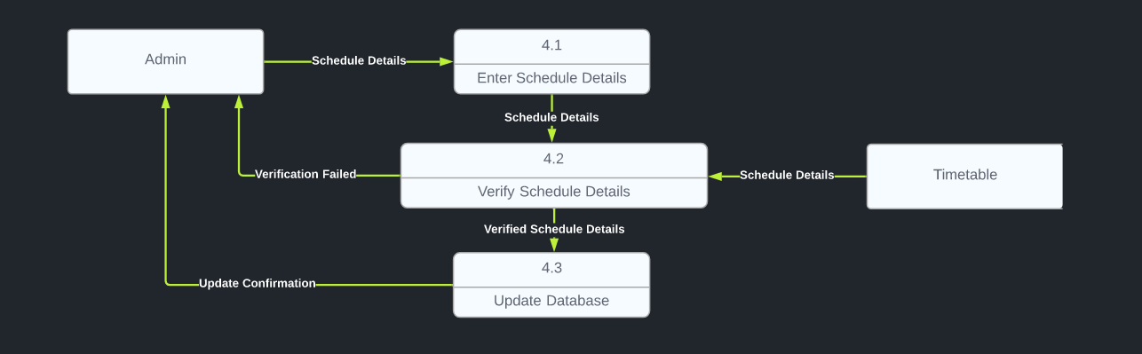
First Level DFD - Admin
4) MOVIE SCHEDULE

Slide 14
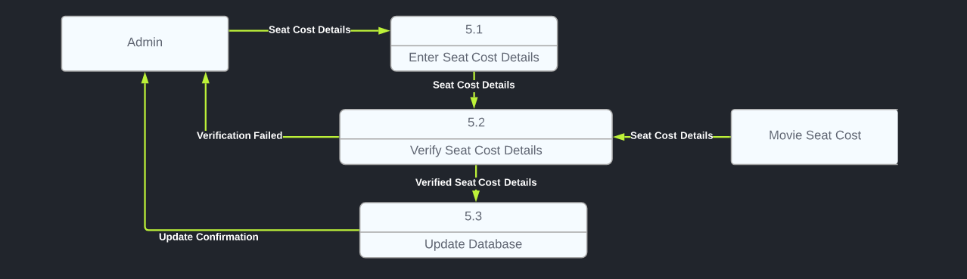
First Level DFD - Admin
5) MOVIE SEAT COST

Slide 15
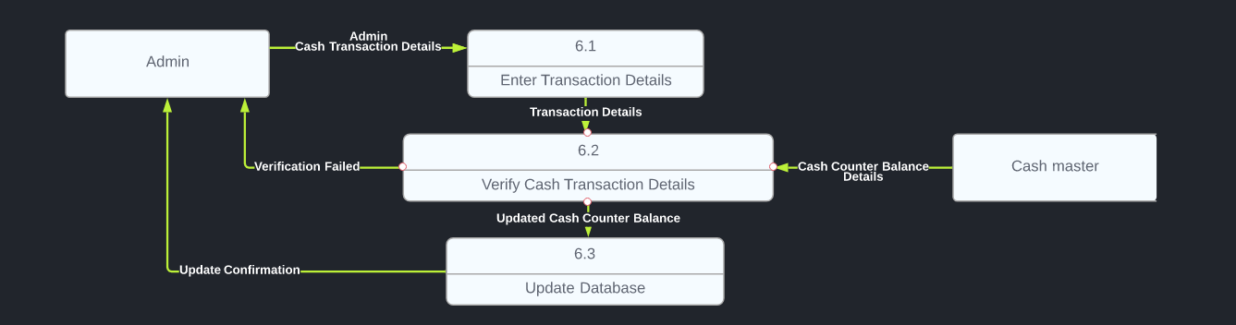
First Level DFD - Admin
6) CASH COUNTER MANAGEMENT

Slide 16
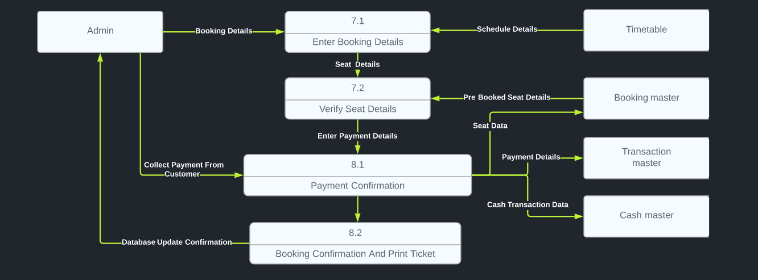
First Level DFD - Admin
7/8) TICKET BOOKING / PAYMENT

Slide 17
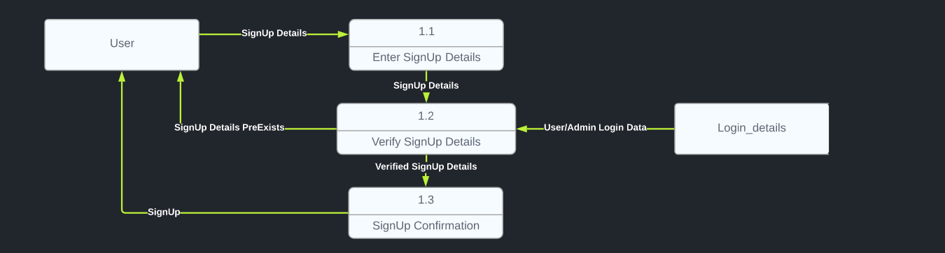
First Level DFD - User
1) SIGN UP

Slide 18
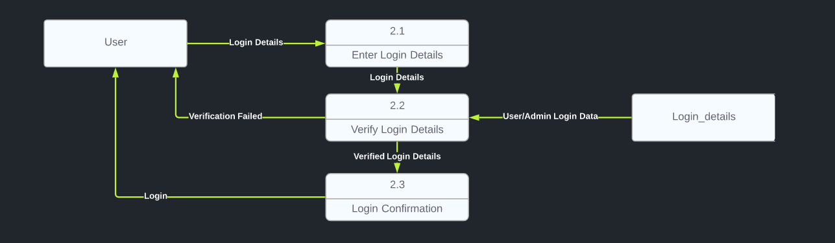
First Level DFD - User
2) LOG IN

Slide 19
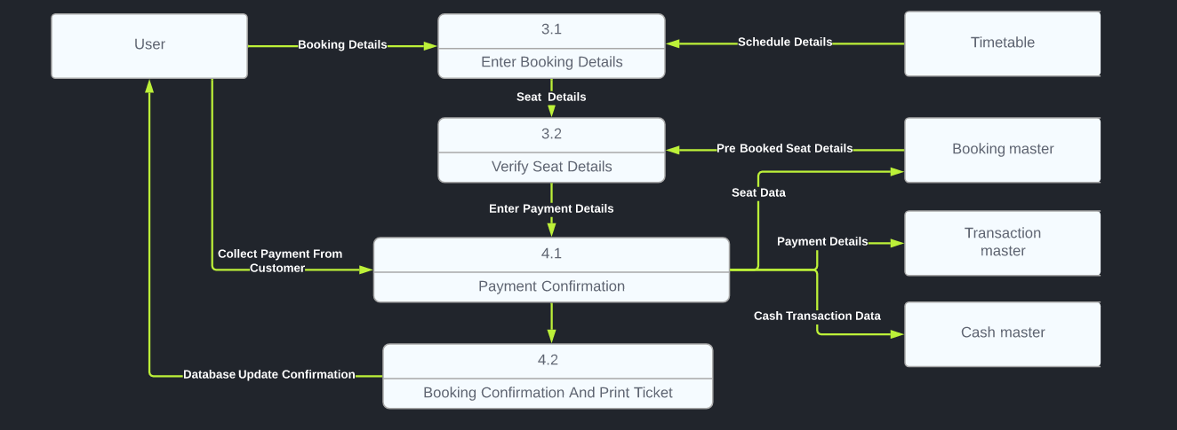
First Level DFD - User
3/4) TICKET BOOKING / PAYMENT

Slide 20
Design Of Input / Output Screens

Slide 21
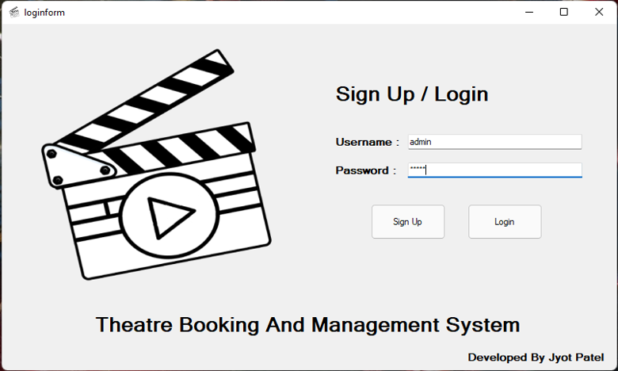
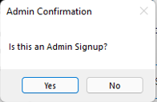
Sign Up / Login Window
When Clicked Sign Up…
( Yes -> Admin , No -> Employee/User )

Slide 22
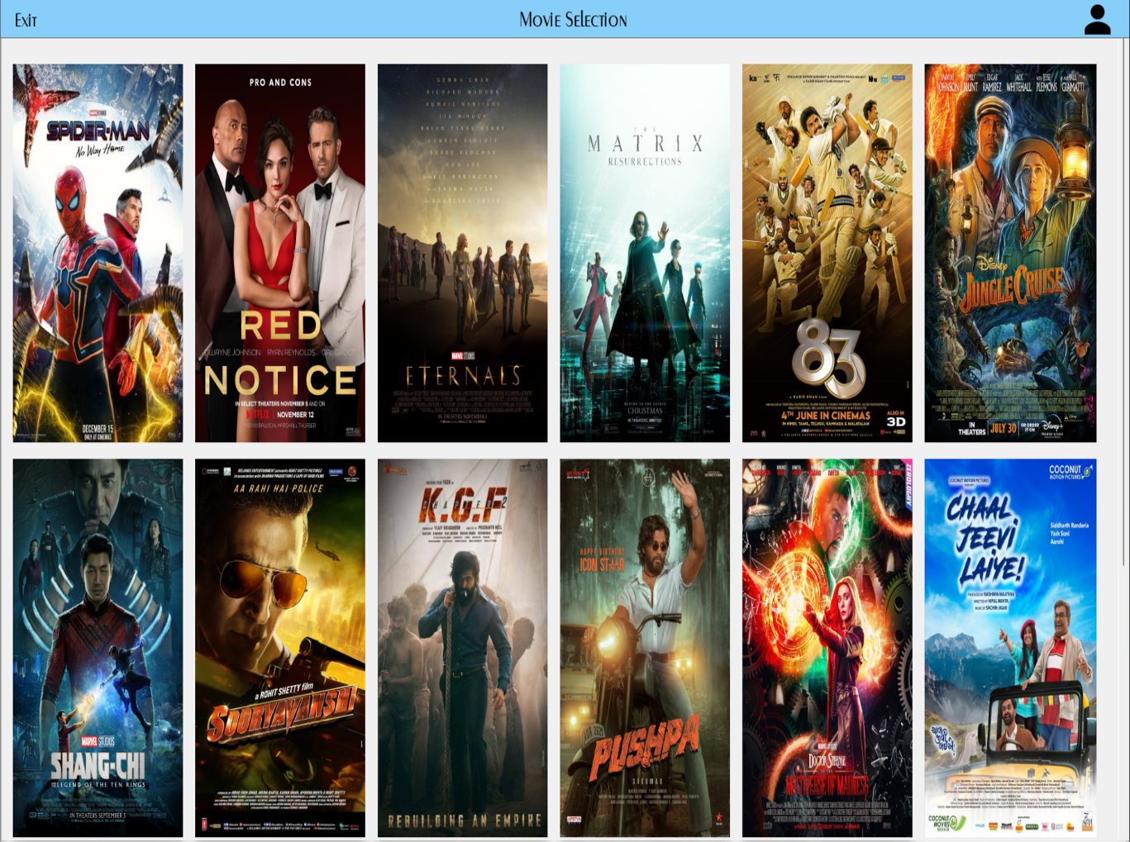
Movie Selection Window
Movie posters are click-able to navigate to Show Selection and Seat Selection Window
Administrator login has an Admin logo on Top-Right to navigate to Admin Interface Window.
Employee / User login only has option to log-off.

Slide 23
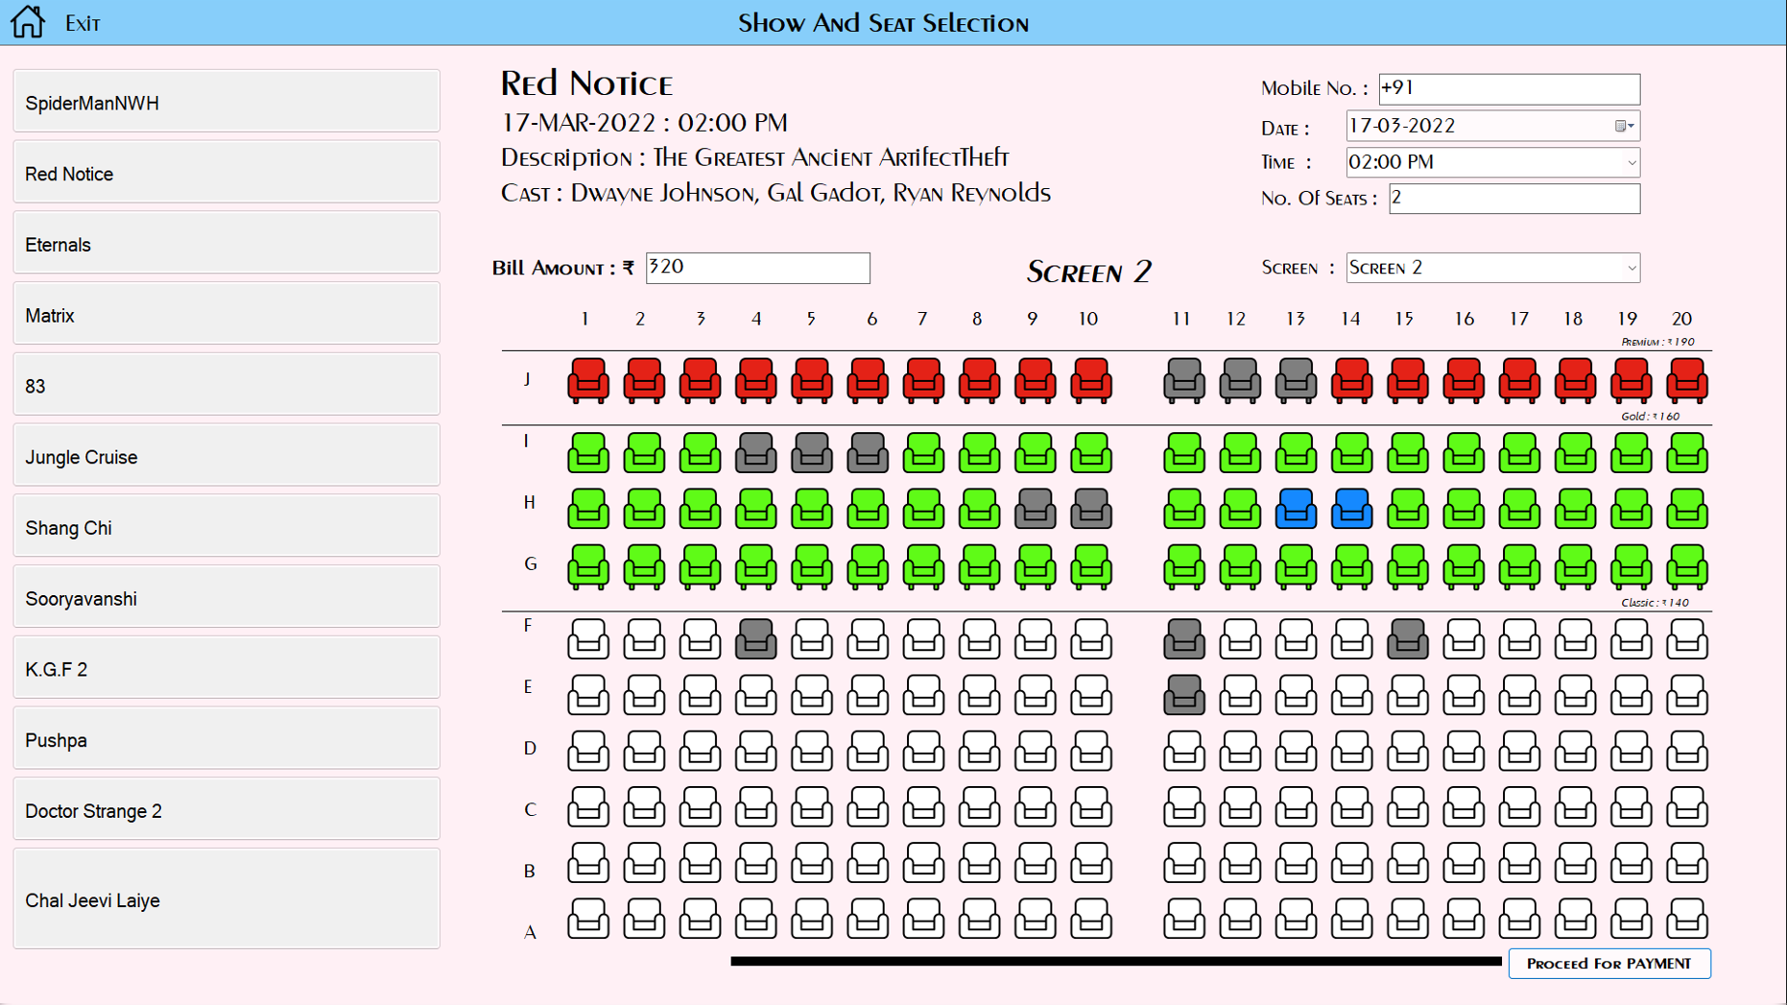
Show And Seat Selection Window
Movies Can Be Selected From Left Panel.
Customers Mobile Number is required for reference (optional).
Details for the Show for the Movie are to be selected.
Total Bill Amount and Total Seats Selected is displayed.

Slide 24
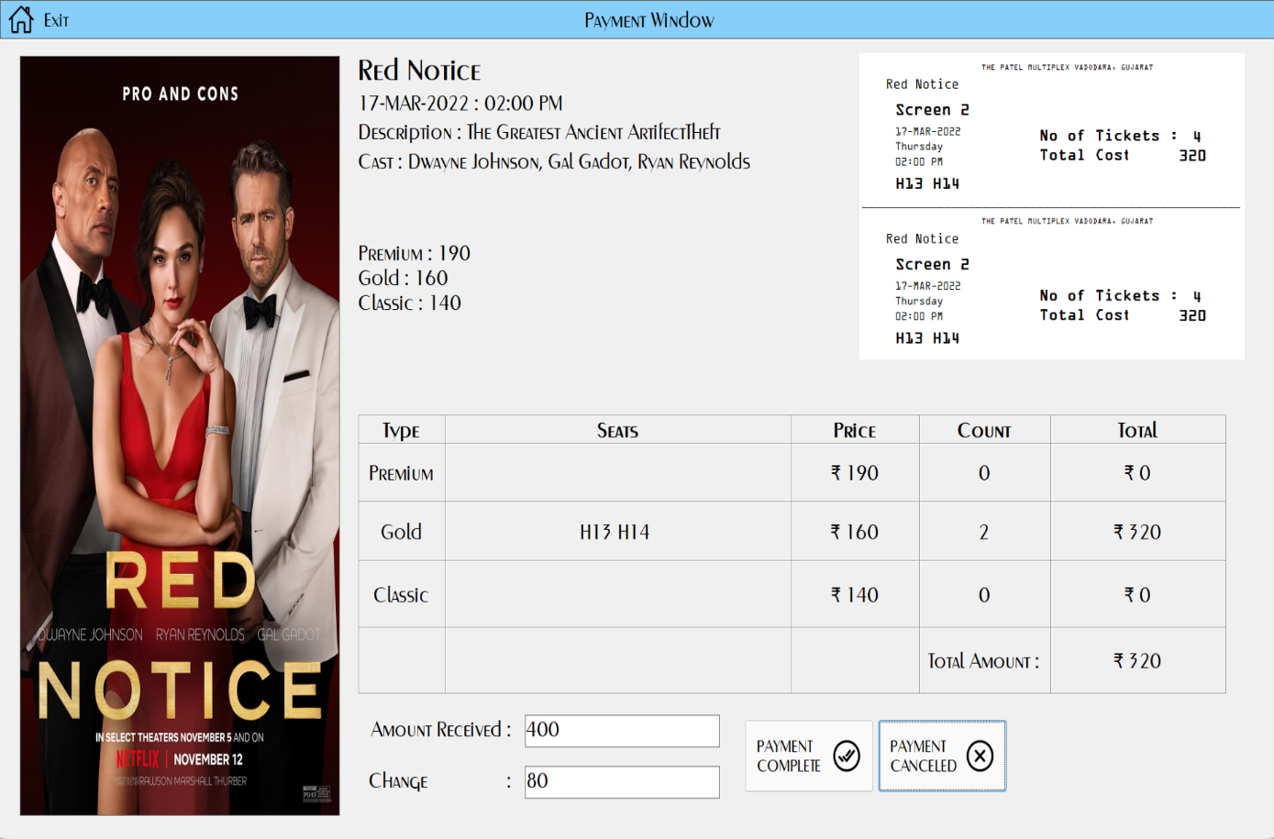
Payment Window
Amount Received from customer is entered.
Change is automatically calculated.
If the payment is complete, the displayed ticket is printed.
If payment is canceled, the ticket is not printed.
And then, application is redirected to Movie Selection Window.

Slide 25
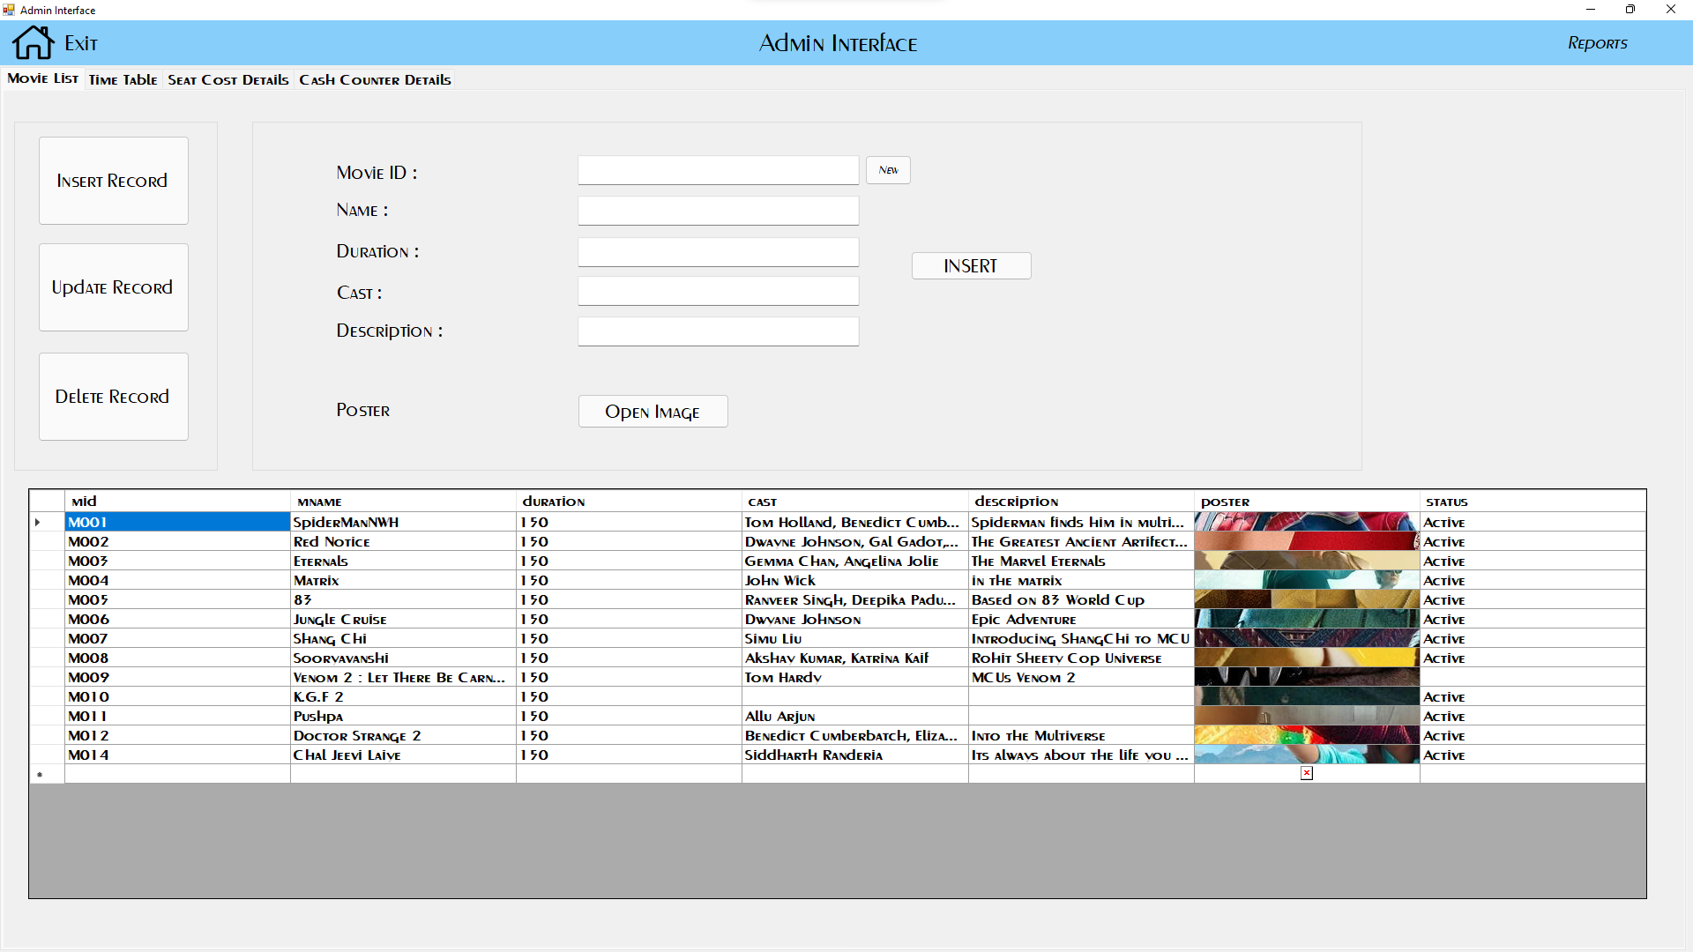
Admin Interface Window
TAB – MOVIE LIST
Movie List Tab provides the administrator complete control on Movie List Database
Administrator can Insert, Update, Delete information about a new / existing movie in the database.
Administrator can select which movies to be displayed in application using the “status” property for a movie.

Slide 26
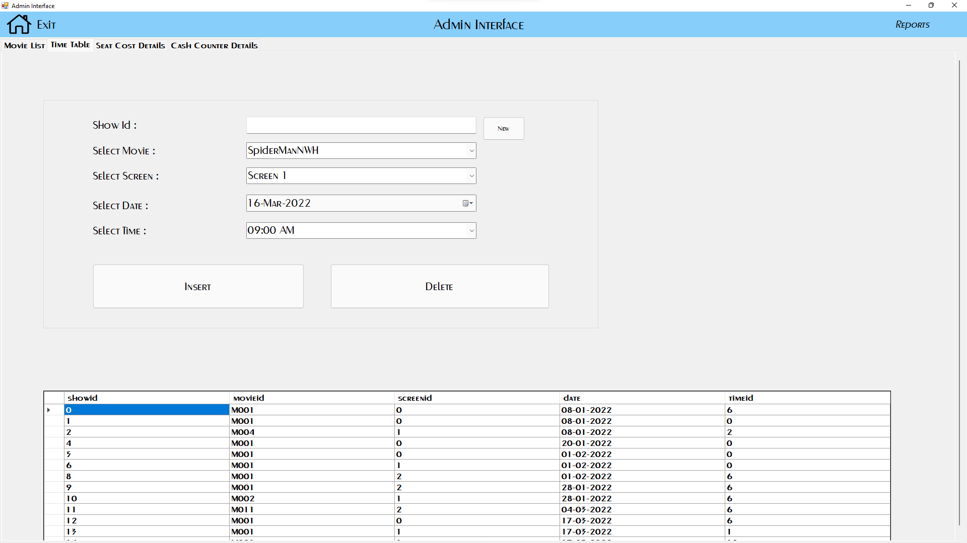
Admin Interface Window
TAB – TIMETABLE
Time Table Tab provides the administrator complete control on Time Table Database to schedule show timings
Administrator can Insert, Delete Show timing information about an existing movie in the database.

Slide 27
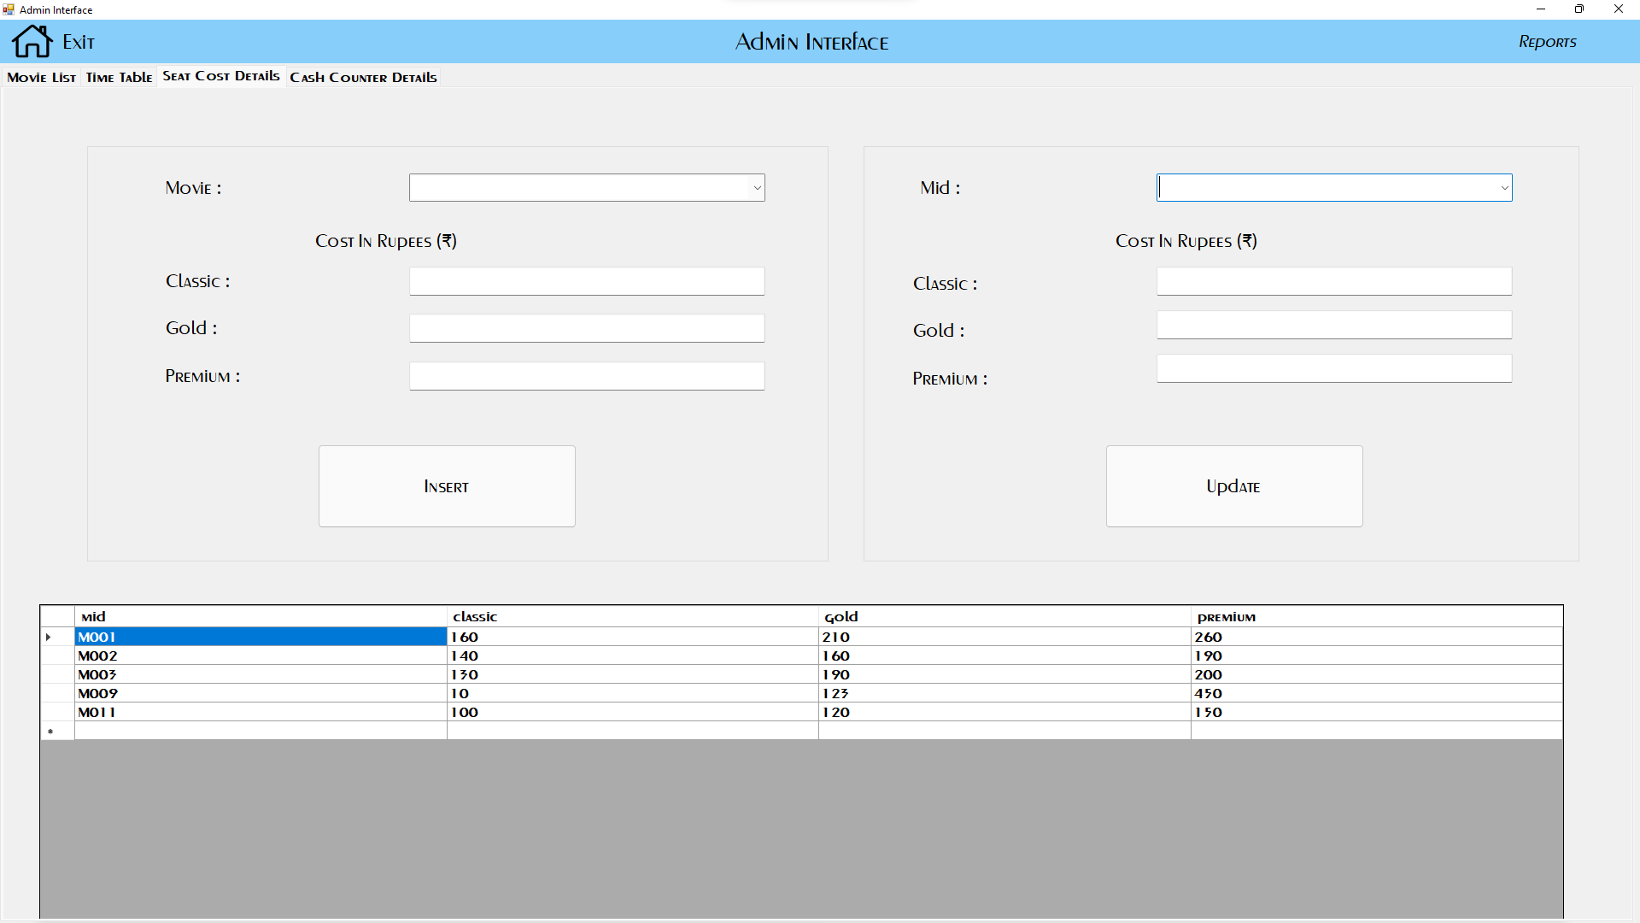
Admin Interface Window
TAB – SEAT COST DETAILS
Seat Cost Details Tab provides the administrator complete control on Seat Price Database.
Administrator can Insert, Update seat prices for an existing movie in the database.

Slide 28
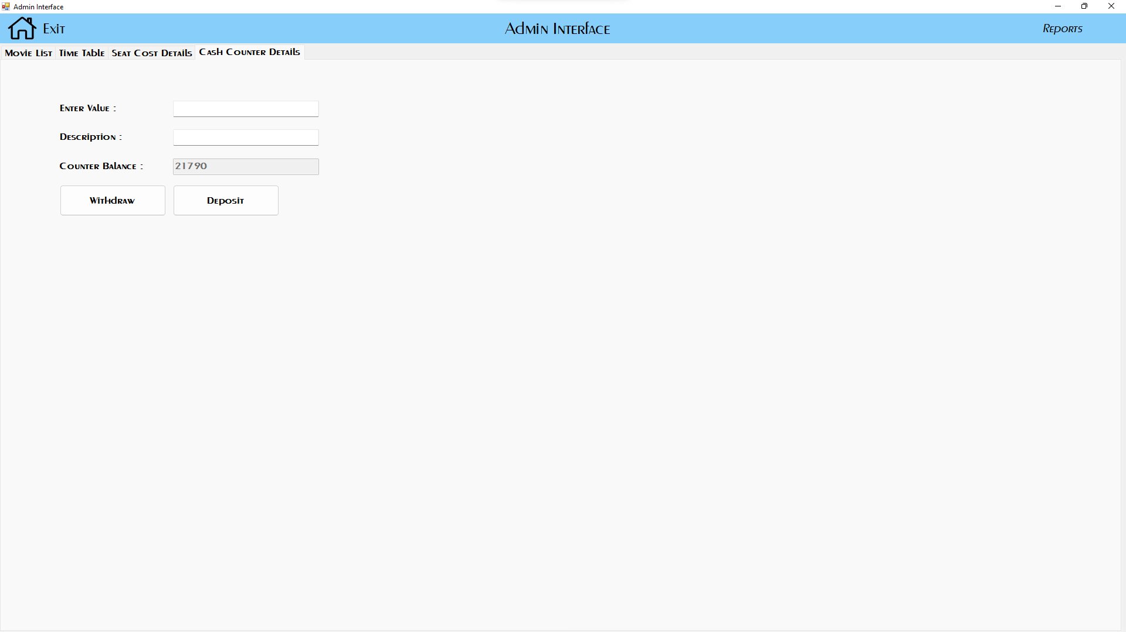
Admin Interface Window
TAB – CASH COUNTER DETAILS
Cash Counter Details Tab provides the administrator control on Cash Counter Database.
Administrator can Withdraw or Deposit Money from the Box Office Cash Counter. And that transaction can be recorded using this tab.

Slide 29
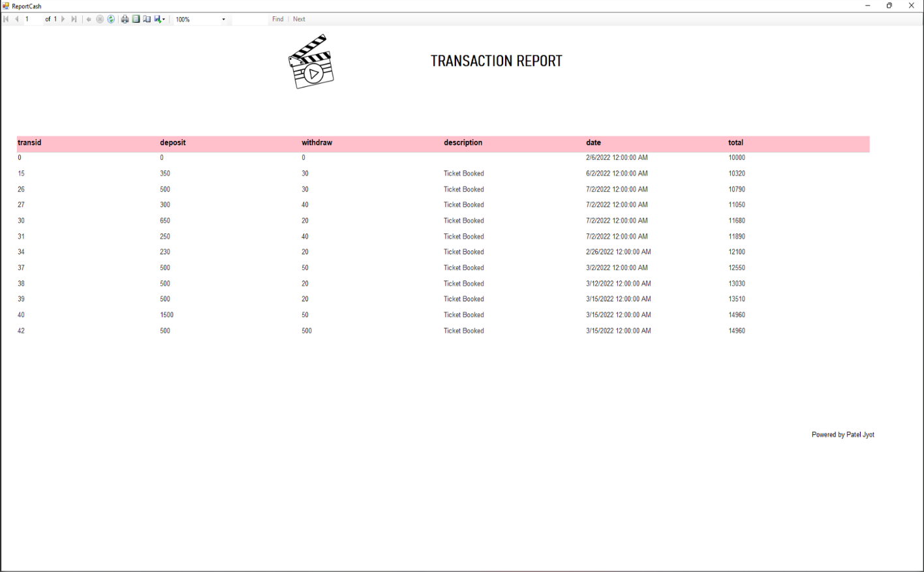
Reports
Cash Transaction Report from Cash Counter Report

Slide 30
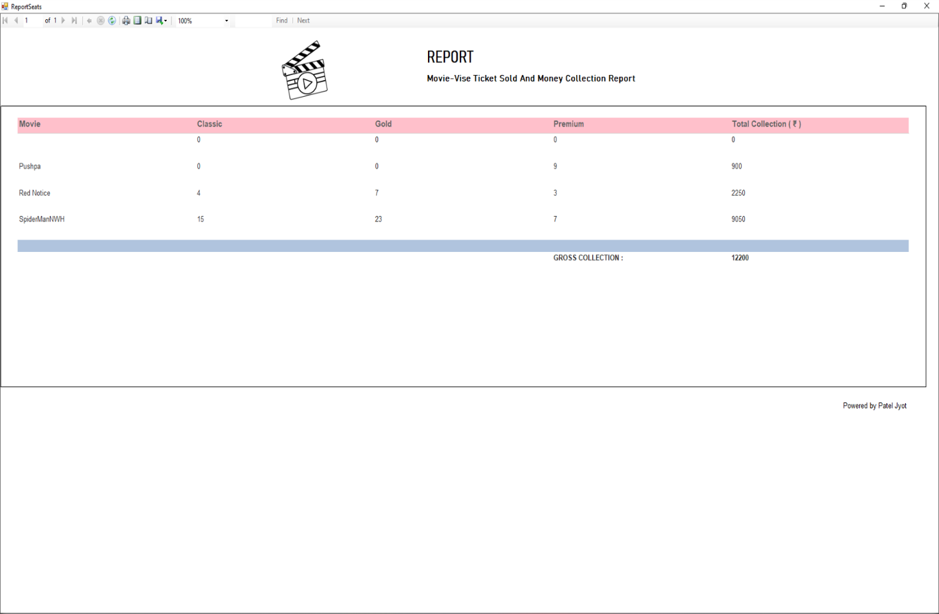
Reports
Movie-wise Ticket Sold and Gross Collection Report

Slide 31

Limitations
A Movie Schedule should be displayed, for the ease of selection for the customer.
Easier way of show selection should be introduced to the system.
Application runs on a single computer.
Tickets can only be booked offline.

Slide 32
Practice doesn’t make one Perfect Practice makes Improvement” - The Writer

Slide 33
Thank You…

